Slide 1

SAP HANA Workshop
Kapitola 3: Administrace
Jakub Vajda, konzultant

Slide 2
SAP HANA maintenance
Backup & recovery
Multitenancy

Slide 3
SAP HANA maintenance
Backup & recovery
Multitenancy

Slide 4
SAP HANA - Administrace
Maintenance - Start/Stop

Slide 5
SAP HANA - Administrace
Maintenance - Start/Stop (commandline)

Slide 6
SAP HANA - Administrace
Maintenance - Start/Stop (commandline)

Slide 7
SAP HANA - Administrace
Maintenance – process list (commandline)

Slide 8
SAP HANA - Administrace
Maintenance - Start/Stop (cockpit)

Slide 9
SAP HANA - Administrace
Maintenance - Start/Stop (cockpit)

Slide 10
SAP HANA - Administrace
Konfigurace (cockpit)

Slide 11
SAP HANA - Administrace
Konfigurace (cockpit)

Slide 12
SAP HANA - Administrace
Konfigurace (commandline)

Slide 13
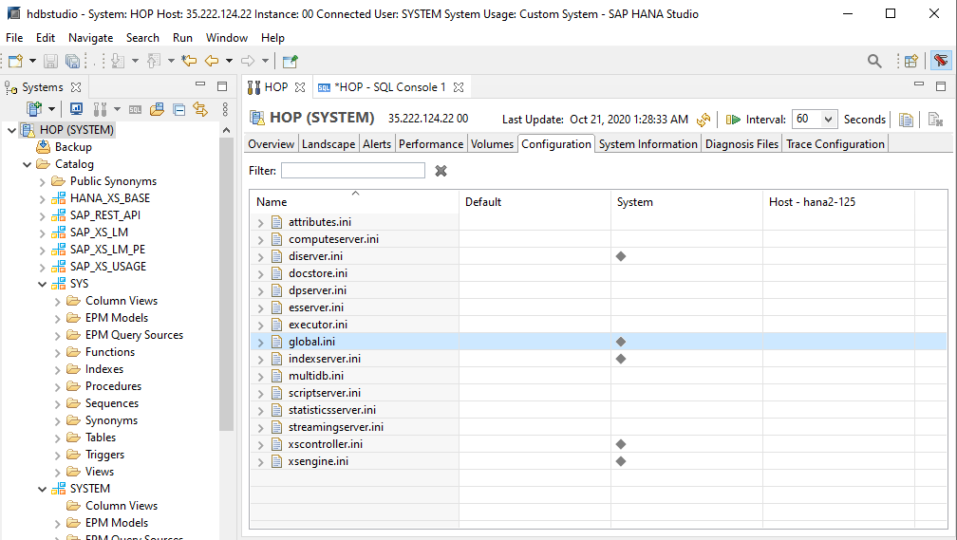
SAP HANA - Administrace
Konfigurace (HANA studio)

Slide 14
SAP HANA maintenance
Backup & recovery
Multitenancy

Slide 15
SAP HANA - Administrace
Backup

Slide 16
SAP HANA - Administrace
Backup

Slide 17
SAP HANA - Administrace
Backup

Slide 18
SAP HANA - Administrace
Backup – required authorizations
Task | Required authorizations
Back up SAP HANA using SAP HANA cockpit or SAP HANA studio | BACKUP ADMIN or BACKUP OPERATOR
 | CATALOG READ This privilege is required to collect the information needed by the backup wizard
Back up the database without a user interface | BACKUP ADMIN or BACKUP OPERATOR (recommended for batch users only)
Recover the database without a user interface | This is supported for an SAP HANA single container system or the system database in an SAP HANA multitenant data-base container. The recovery is executed as the operating system user (<sid>adm). You therefore require the logon credentials of this user.
Physically delete data, and log backups and obsolete versions of the backup catalog from the backup location | BACKUP ADMIN
Administration tasks executed on a tenant database through the system database | DATABASE ADMIN

Slide 19
SAP HANA - Administrace
Data Area Backup

Slide 20
SAP HANA - Administrace
Data Area Backup

Slide 21
SAP HANA - Administrace
ini files backup

Slide 22
SAP HANA - Administrace
Perform recovery

Slide 23
SAP HANA - Administrace
Perform recovery (wizard)

Slide 24
SAP HANA maintenance
Backup & recovery
Multitenancy

Slide 25
SAP HANA - Administrace
Distributed filesystem installation

Slide 26
SAP HANA - Administrace
Scaling

Slide 27
SAP HANA - Administrace
Scale-out

Slide 28
SAP HANA - Administrace
Scale-out

Slide 29
SAP HANA - Administrace
Scale-out

Slide 30
SAP HANA - Administrace
Scale-out minimal setup

Slide 31
SAP HANA - Administrace
Typical configuration for a distributed system

Slide 32
SAP HANA - Administrace
High Availibility

Slide 33

THANK YOU
linkedin.com/company/mdsap
@MDSapTech
slideshare.net/MDSapTech
www.mdsaptech.com

